Slide 1





PRESENTATION 2026
FacultyBalance-AI Assisted Faculty Time Allocation
Mentor Name
Faculty Email
Faculty Name
Ms.Uma Maheswari
Chrama.24@gmail.com
Dr Rama Mokkarala

Slide 2

Outline
Abstract of the Project
Problem Statement
Proposed Solution
System Architecture
Live Demo of the Project
Embedded Video of Project
Conclusion
Future Scope

Slide 3
Abstract
Develops a unified dataset
Quantifies Imbalances & Proposes redistribution strategies
Tools & Technologies: Excel + Power BI + Copilot
Expected outcomes :
A Unified and cleaned Dataset.
An interactive Dashboard
Key Highlights:
Comprehensive workload summaries
Fairer workload allocation
strengthen departmental research capacity.

Slide 4

Problem Statement
Core Problem: Institutions lack a unified and data-driven mechanism
Significance of the problem: Administrative decisions taken increase the risk of burnout, inefficiency, and suboptimal academic outcomes
Faculty Members of Higher Education Institutions
Web Based Models & lack of AI assisted Models
Scope & Boundaries: Unified Real Time Data collection, data cleaning, visualization, report generation, and AI assisted insights.

Slide 5

Proposed Solution
To develop a unified dataset
Teaching Hours
Research
Administrative responsibilities
To design an interactive Power BI dashboard
Visualizes workload distribution at individual & departmental levels
Provides Teaching KPIS, Service Hours KPIs and Balance KPIs
To integrate AI and generate workload summaries
Methodology & Tools: Excel, Power Query Editor, Power BI, Copilot

Slide 6
Key Advantages
Comprehensive Workload Visibility
Enhanced Decision Support
Data Driven Redistribution
Leverages AI tools like Copilot to accelerate analysis and reduce human error
Improved Research Time Allocation
Cost-effective
Early Imbalance Detection
Fairness and Morale

Slide 7
System Architecture
Data Input / Source
Processing / Analysis
Real Excel Dataset with 109 rows and 25 columns
Primary sources: Departmental workload documents and timetables
IQAC committee allocation sheet
Power Query to normalize text and numeric formats
Apply Business rules
Computed derived fields
Used Power BI for dashboard development
AI / Tool Integration
Output / Dashboard
Excel used for Data input and cleaning using Power query editor.
Power BI to develop visualizations Dashboard
Copilot was used to generate insightful summaries for actionable insights
Dashboard -
Departmental KPIS,
Teaching KPI, Research
Admin KPIs and Balance KPIS

Slide 8
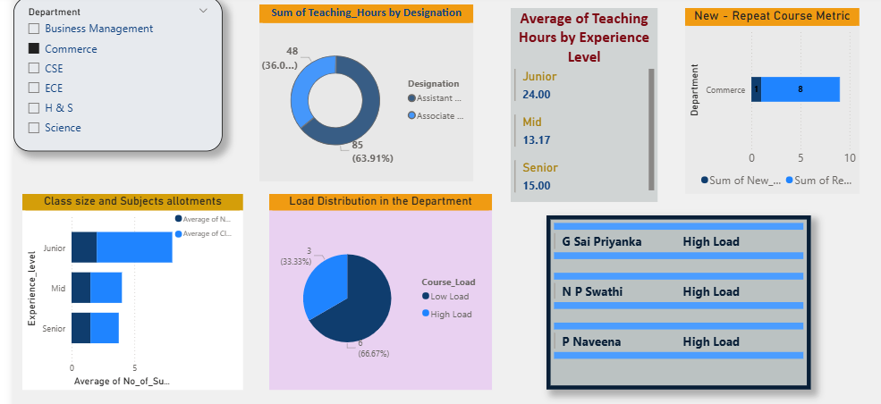
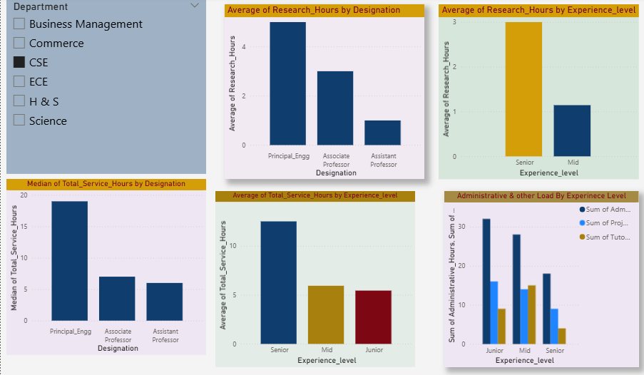
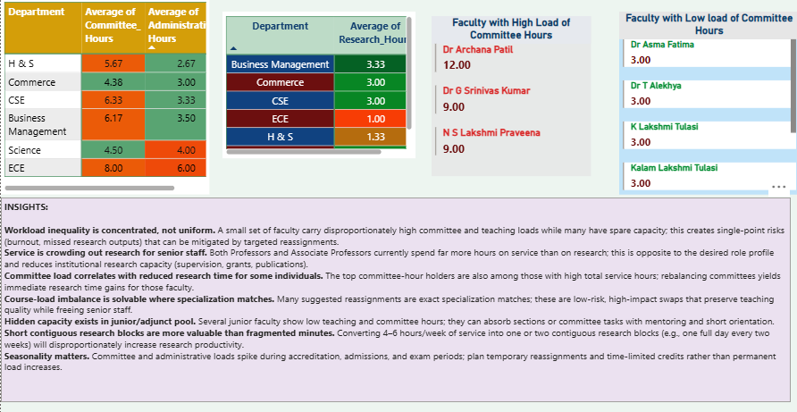
Live Demo of Project
Here's the list of some demo screenshots / features of the project:
Teaching KPIs:
Department‑wise teaching load distribution
New course allocations
Class size
Teaching Hours by Experience Level
High‑load faculty Visualized
Department wise averages of Research, Service & Administrative hours.
Highlighting correlations
AI generated insights guiding fair reallocation and improved research time
Research hours shown categorically
Median and total service hours. Administrative loads are categorized by experience,
A clear view of balance and alignment with institutional norms

Slide 9
Video of Project Demo
https://drive.google.com/file/d/1NbMxvTWPDAGRVnNG-6_xxWixgY8ucYGF/view?usp=drive_link
▶
[Insert your project demo video.
You can embed a video your live project.]

Slide 10

Conclusion
The project successfully developed a unified and cleaned dataset that integrates both teaching parameters and service components
The dashboard highlighted key Teaching Indicators
The dashboard captured Research and Service hours, revealing that reducing excessive service commitments can create opportunities to increase research productivity.
The imbalance detection and redistribution modelling offered actionable insights for fairer workload allocation.
The project further benefited from AI‑assisted insights through Copilot, which enriched the analysis with interpretive commentary and practical suggestions.
Overall, the project contributes to fair and equitable workload distribution, which enhances faculty satisfaction, reduces stress, and strengthens the institution’s research and teaching capacity.
CONCLUSION

Slide 11

Future Scope
Integrate real-time data pipelines using Power Automate or API connections.
Apply machine learning models
Build a web-based interface or Power Apps solution for non-technical end users
The incorporation of normalization models
To develop a chatbot interface to have a conversational flow
To develop a tool for faculty to check their workload and understand if they are within the limits specified.

Slide 12
Thank You
AICW Fellowship | Student Project Presentation 2026
LinkedIn | Edunet Foundation

